Slide 1
Chemical reactions

Slide 2
By the end of this lesson, you should be able to:
Identify combination and decomposition reactions;
Identify acid reactions;
Identify precipitation reactions;
Identify redox reactions.

Slide 3

Combination reactions (sometimes known as synthesis reactions) occur when multiple reactants combine to form a single product.
The product is a completely new compound, with very different properties to the reactants used in the reaction. Combination reactions can be represented with the following general equation:
X + Y → XY

Slide 4

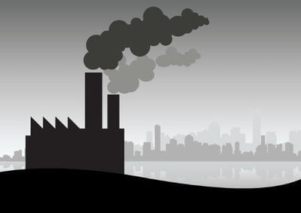
One example of a combination reaction would be the production of carbon dioxide gas, which can have a major impact on the environment.
Two reactants combined to form a single product - therefore this is a combination reaction!

Slide 5

Decomposition reactions occur when a single reactant breaks apart to form multiple products.
This can be represented with the following general equation:
XY → X + Y

Slide 6

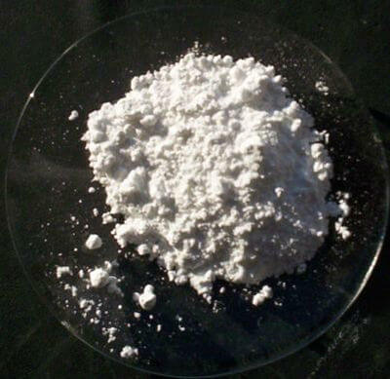
An example of a decomposition reaction would be heating calcium carbonate.
This reaction gives off carbon dioxide gas and leaves calcium oxide, otherwise known as quicklime, behind.
One reactant broke down to form two products - therefore this is a decomposition reaction!

Slide 7
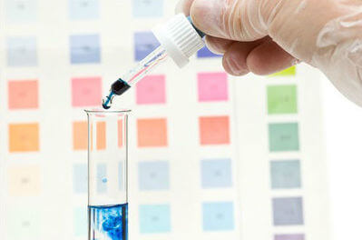
The pH is a measure of how many hydrogen ions are present in a solution.
Counter-intuitively, the lower the pH is, the more hydrogen ions (H⁺) there are!
Acids are compounds with a pH lower than 7.
Water is considered neutral and has a pH equal to 7.
Bases are compounds with a pH greater than 7.

Slide 8

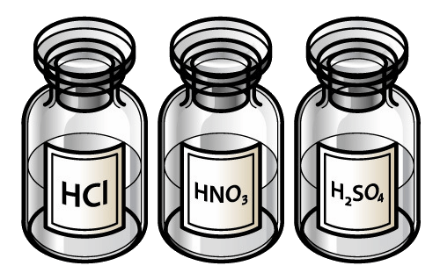
An example of an acid is hydrochloric acid.
Hydrochloric acid, HCl, dissolves entirely in water to produce hydrogen ions (H⁺) and chloride ions (Cl⁻).

Slide 9
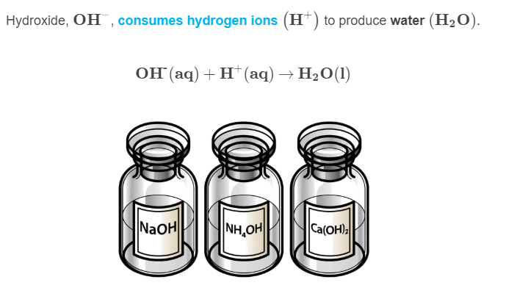
An example of a base is the hydroxide ion.

Slide 10
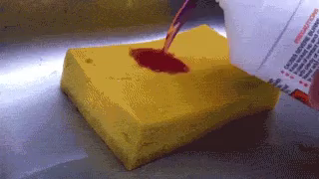
Acids undergo three important reactions:
Neutralisation reactions between acids and bases.
Acid-carbonate reactions between acids and metal carbonates or hydrogen carbonates.
Acid-metal reactions between acids and metals.

Slide 11

Neutralisation reactions occur between acids and bases.
They have the form:
acid + base → salt + water

Slide 12
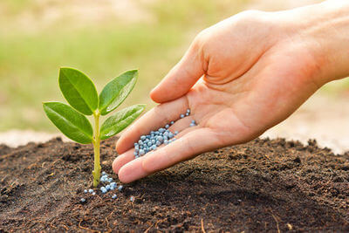
Neutralisation reactions are very important for maintaining pH values.
For example, many plants cannot grow in acidic soil, but urea (a base) can be used to bring the pH to a healthy level.
acidic soil + urea → salt + water
Because the acid has been turned into water, the soil is now less acidic.

Slide 13
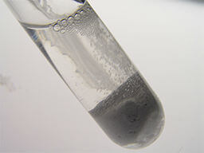
Acid-carbonate reactions occur between acids and carbonates to form salt, water and carbon dioxide.
They have the form:
acid + carbonate → salt + carbon dioxide + water

Slide 14
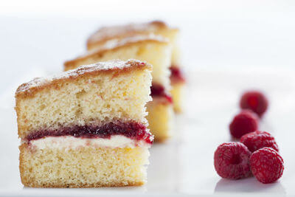
If you enjoy baking, then you can thank acid-carbonate reactions!
Adding an acid (such as buttermilk) and a carbonate (such as baking soda) to your cooking mixture will produce bubbles of carbon dioxide which cause the baked goods to rise.
buttermilk + baking soda → salt + carbon dioxide + water
The carbon dioxide is what makes sponge cakes spongy!

Slide 15
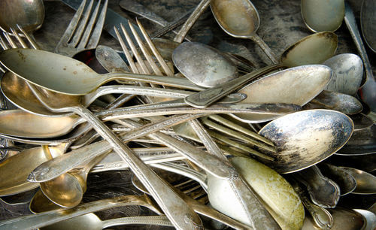
Acid-metal reactions occur between acids and metals.
They have the form:
acid + metal → salt + hydrogen gas

Slide 16
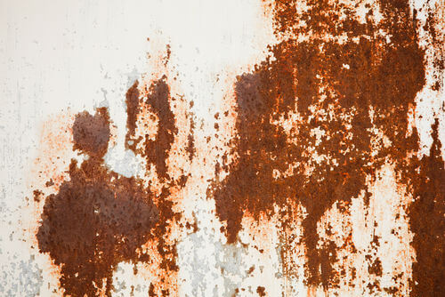
One of the reasons acid rain can be incredibly damaging, is because it will undergo an acid-metal reaction with metal roofs and walls, and corrode them!

Slide 17
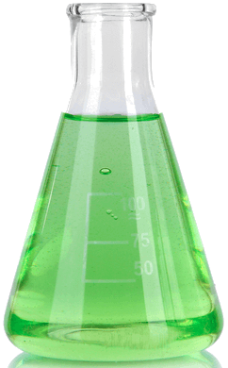
Precipitation reactions occur when multiple soluble reactants combine to form an insoluble product, known as the precipitate.
A soluble substance is one which dissolves, such as table salt in water.
An insoluble substance is one which does not dissolve, such as chalk in water.

Slide 18
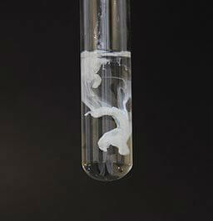
During a precipitation reaction, the solution will go from clear to cloudy.
This happens because the insoluble product is forming a solid, which is known as precipitation.
A clear solution may be coloured, like food colouring in water, but you can still see through it!

Slide 19
